Slide 1
Form control
Taught by Yossef Ayman Zedan

Slide 2
Form control
This is the class that is added to the inputs and text areas to give it styles that differs from the basic HTML5
Example:
<div class="mb-3">
<label for="exampleFormControlInput1" class="form-label">Email address</label> <input type="email" class="form-control" id="exampleFormControlInput1" placeholder="name@example.com">
</div>
<div class="mb-3">
<label for="exampleFormControlTextarea1" class="form-label">Example textarea</label>
<textarea class="form-control" id="exampleFormControlTextarea1" rows="3"></textarea>
</div>

Slide 3
Sizing
Set heights using classes like .form-control-lg and .form-control-sm.
<input class="form-control form-control-lg" type="text" placeholder=".form-control-lg" >
<input class="form-control" type="text" placeholder="Default input">
<input class="form-control form-control-sm" type="text" placeholder=".form-control-sm">

Slide 4
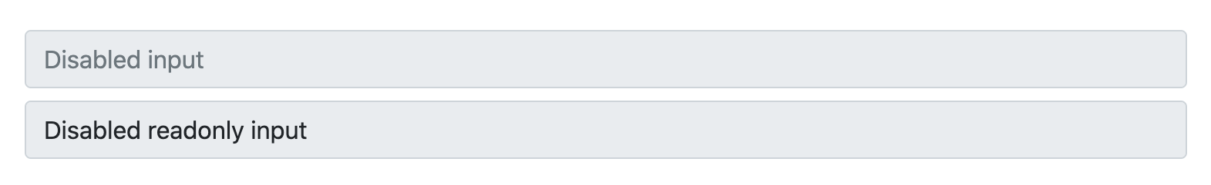
Disabled
Add the disabled boolean attribute on an input to give it a grayed out appearance and remove pointer events.
<input class="form-control" type="text" placeholder="Disabled input" disabled>
<input class="form-control" type="text" value="Disabled readonly input" disabled readonly>

Slide 5
Readonly
Add the readonly boolean attribute on an input to prevent modification of the input’s value.
<input class="form-control" type="text" value="Readonly input here….” readonly>

Slide 6
Readonly plain text
If you want to have <input readonly> elements in your form styled as plain text, use the .form-control-plaintext class to remove the default form field styling and preserve the correct margin and padding.
<div class="mb-3 row">
<label for="staticEmail" class="col-sm-2 col-form-label">Email</label>
<div class="col-sm-10">
<input type="text" readonly class="form-control-plaintext" id="staticEmail" value="email@example.com">
</div>
</div>

Slide 7

Readonly plain text
<div class="mb-3 row">
<label for="inputPassword" class="col-sm-2 col-form-label">Password</label>
<div class="col-sm-10">
<input type="password" class="form-control" id="inputPassword"> </div> </div>

Slide 8
Readonly plain text
<form class="row g-3">
<div class="col-auto">
<label for="staticEmail2" class="visually-hidden">Email</label>
<input type="text" readonly class="form-control-plaintext" id="staticEmail2" value="email@example.com">
</div>
<div class="col-auto">
<label for="inputPassword2" class="visually-hidden">Password</label>
<input type="password" class="form-control" id="inputPassword2" placeholder="Password">
</div>

Slide 9

Readonly plain text
<div class="col-auto">
<button type="submit" class="btn btn-primary mb-3">Confirm identity</button>
</div>
</form>

Slide 10
Default file input example
<div class="mb-3">
<label for="formFile" class="form-label">Default file input example</label>
<input class="form-control" type="file" id="formFile">
</div>

Slide 11
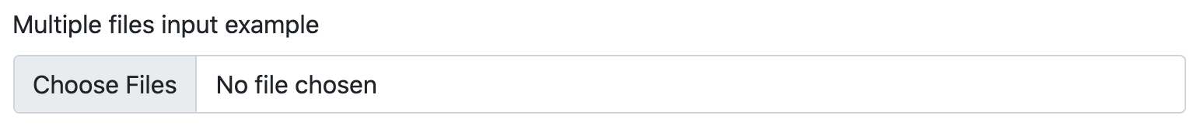
Multiple files input example
<div class="mb-3">
<label for="formFileMultiple" class="form-label">Multiple files input example</label> <input class="form-control" type="file" id="formFileMultiple" multiple>
</div>

Slide 12

Disabled file input example
<div class="mb-3">
<label for="formFileDisabled" class="form-label">Disabled file input example</label> <input class="form-control" type="file" id="formFileDisabled" disabled>
</div>

Slide 13
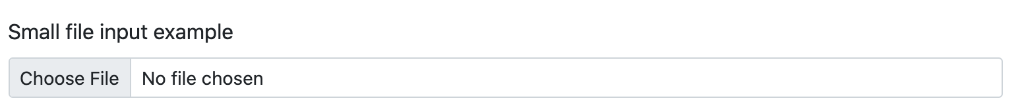
Small file input example
<div class="mb-3">
<label for="formFileSm" class="form-label">Small file input example</label>
<input class="form-control form-control-sm" id="formFileSm" type="file">
</div>

Slide 14
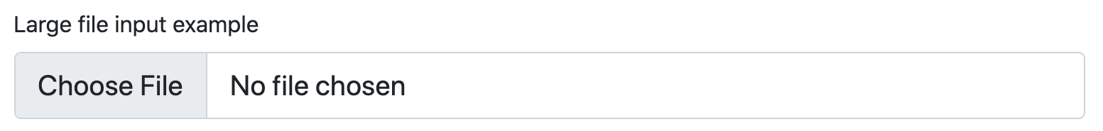
Large file input example
<div class=“mb-3”>
<label for="formFileLg" class="form-label">Large file input example</label>
<input class="form-control form-control-lg" id="formFileLg" type="file">
</div>

Slide 15
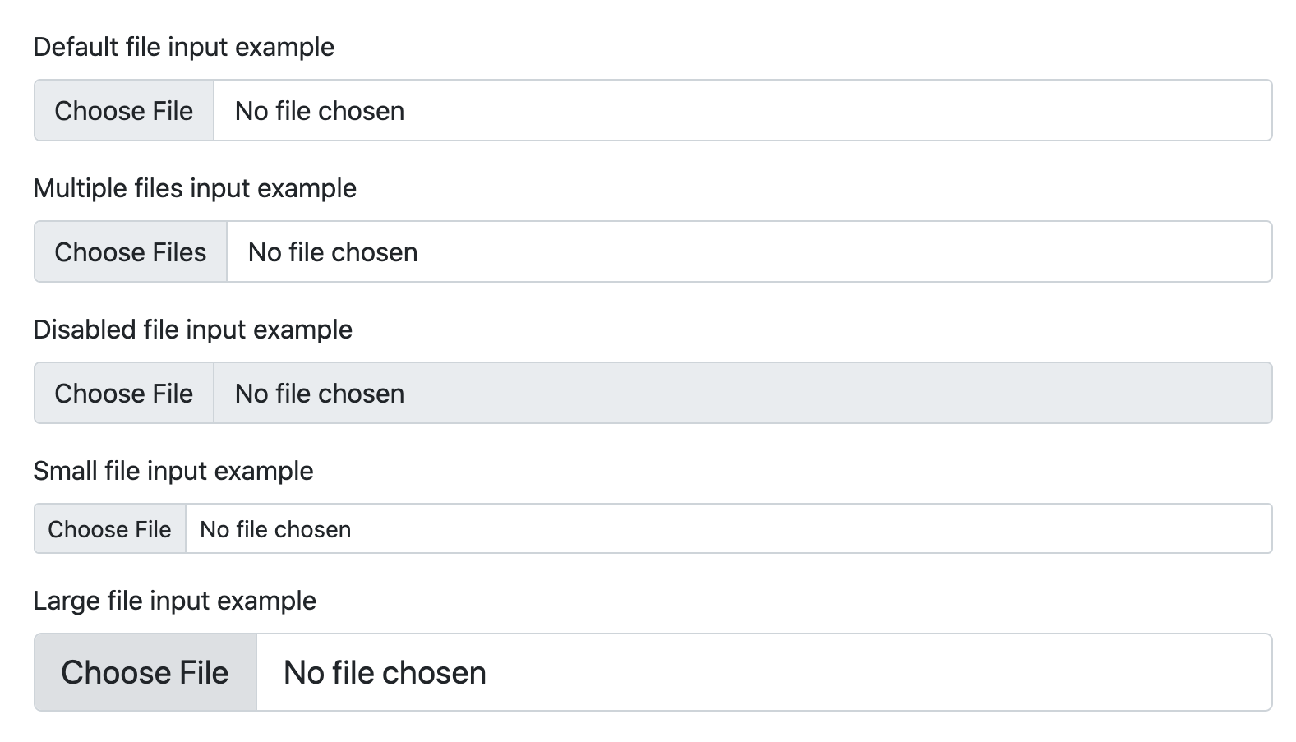
All inputs in one image

Slide 16
Color picker
<label for="exampleColorInput" class="form-label">Color picker</label>
<input type="color" class="form-control form-control-color" id="exampleColorInput" value="#fff" title="Choose your color">

Slide 17
Datalists
Datalists allow you to create a group of <option>s that can be accessed (and autocompleted) from within an <input>. These are similar to <select> elements, but come with more menu styling limitations and differences. While most browsers and operating systems include some support for <datalist> elements, their styling is inconsistent at best.
<label for="exampleDataList" class="form-label">Datalist example</label>
<input class="form-control" list="datalistOptions" id="exampleDataList" placeholder="Type to search...">
<datalist id="datalistOptions">
<option value="San Francisco">
<option value="New York">
<option value="Seattle">
<option value="Los Angeles"> <option value="Chicago"> </datalist>

Slide 18
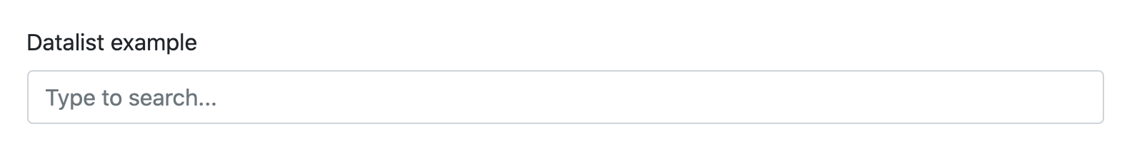
Datalists

